Slide 1
listen …

Slide 2
GES1011/GESS1009
The Evolution of a
Global City-State

Slide 3
decolonisation …

Slide 4
recap ++ …
(European) imperialism ...
best explains global power relations from around 1750s to 1945 …
WW1 and WW2 largely war of empires …

Slide 5
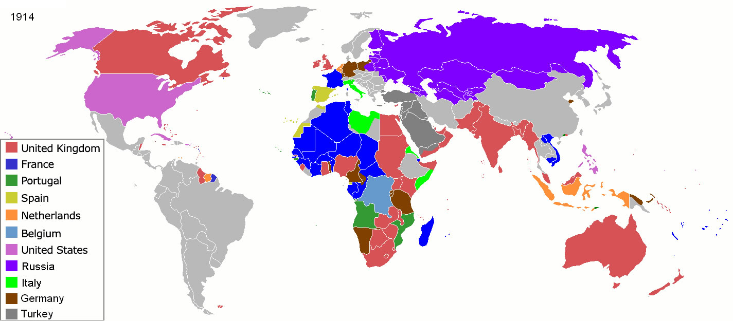
recap ++ …

Slide 6
recap ++ …
Singapore, as part of the Straits Settlements and more widely, British interests on the Malayan peninsula …
experienced a change in imperial circumstances in 1942 …

Slide 7
recap ++ …
this experience ended on 12 September 1945 ...
official date of Japanese surrender …

Slide 8
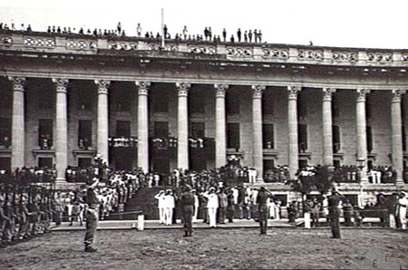
recap ++ …

Slide 9
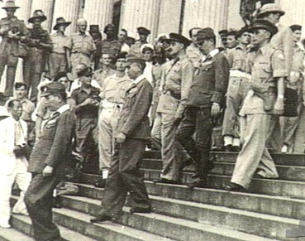
recap ++ …

Slide 10
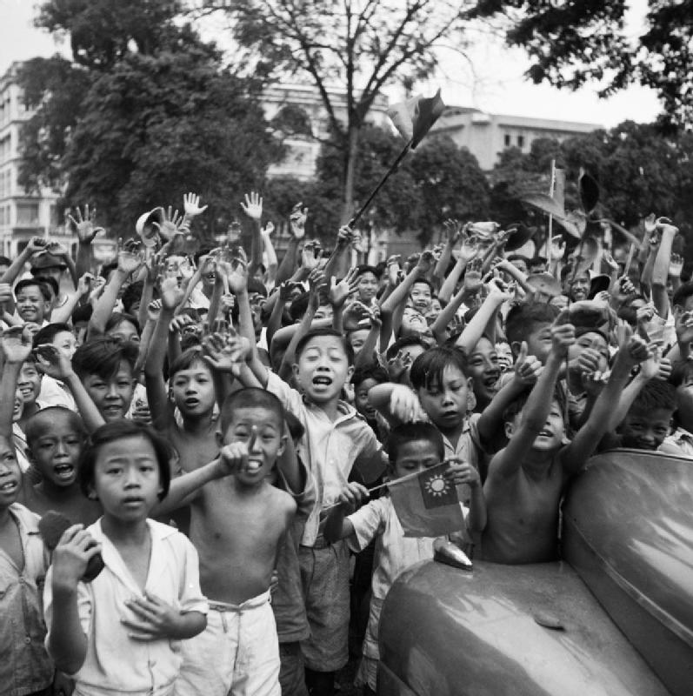
recap ++ …
100,000 ‘locals’/residents of Singapore greeted this event rapturously … ???

Slide 11
recap ++ …
end of overt global imperial military hostilities in 1945, however, did not mark the end of imperial relationships …
experience was varied in different contexts …
British Military Administration …

Slide 12
Question and Response

Slide 13
our task today …
post-war life and political realities …
post-war global political changes …
modifications in the imperial relationship …
interpreting Singapore’s pasts: imperial legacies and the stirrings (and death???) of freedom …

Slide 14
after the war …
in the immediate aftermath of war …
MPAJA (Chinese dominated) and Malay clashes …
ethnic clash but far from wholly because of ethnic differences (stories of human desperation and chaos) …

Slide 15
after the war …
British introduced the Malayan Union proposal:
no special privileges for Malays
power of Malay rulers severely attenuated …
relatively easy path to citizenship for non-Malays …

Slide 16
after the war …
promise of political rights, a measure of self-rule, equality, citizenship …
Singapore to be governed separately from the peninsula …
as a Crown Colony from 1 April 1946 …

Slide 17
after the war …
some members of the pre-war Malay ruling class resisted the Malayan Union proposal …
threatened the (9) Malay rulers …
to reject proposal …
confluence of agitation, threats and transient Malay unity forced British to reconsider …

Slide 18
after the war …
new proposal …
Federation of Malaya Act 1948 (1 Feb 1948) …
more difficult path to citizenship for non-Malays …
(Singapore already a Crown Colony)

Slide 19
after the war …
partly because of this major change in plans …
and British preoccupation with re-establishing order, control and alleviating economic hardship in the form of material shortages …
FREEDOM !!!

Slide 20
after the war …
freedom was used by some quarters like the leftists to politically mobilise (plans to protest FMA) …
signal success …
HARTAL, 20th October 1947 …
freedom given, freedom exercised ...

Slide 21
after the war …
FMA 1948 said to be a reason for Chinese tacit and direct support of Communist Party of Malaya …
planters killed by communists in Perak in April 1948 …
statewide emergency declared, followed by …
Malayan Emergency on 16 June 1948 …
(Singapore follows on 24 June 1948)

Slide 22
after the war …
Emergency Regulations Ordinance 1948
slew of restrictions on:
fundamental liberties like freedom of speech, expression, association ….
preventative detention without trial for one year …
virtual death/suffocation of ‘freedom’ ?
and so it has been ever since ?

Slide 23
after the war …
1949: Lt. Gen Harold Briggs takes over military leadership of communist resistance effort …
1952 Sir Gerald Templer (Tiger of Malaya) appointed High Commissioner as his predecessor, Henry Gurney assassinated in 1951 …

Slide 24
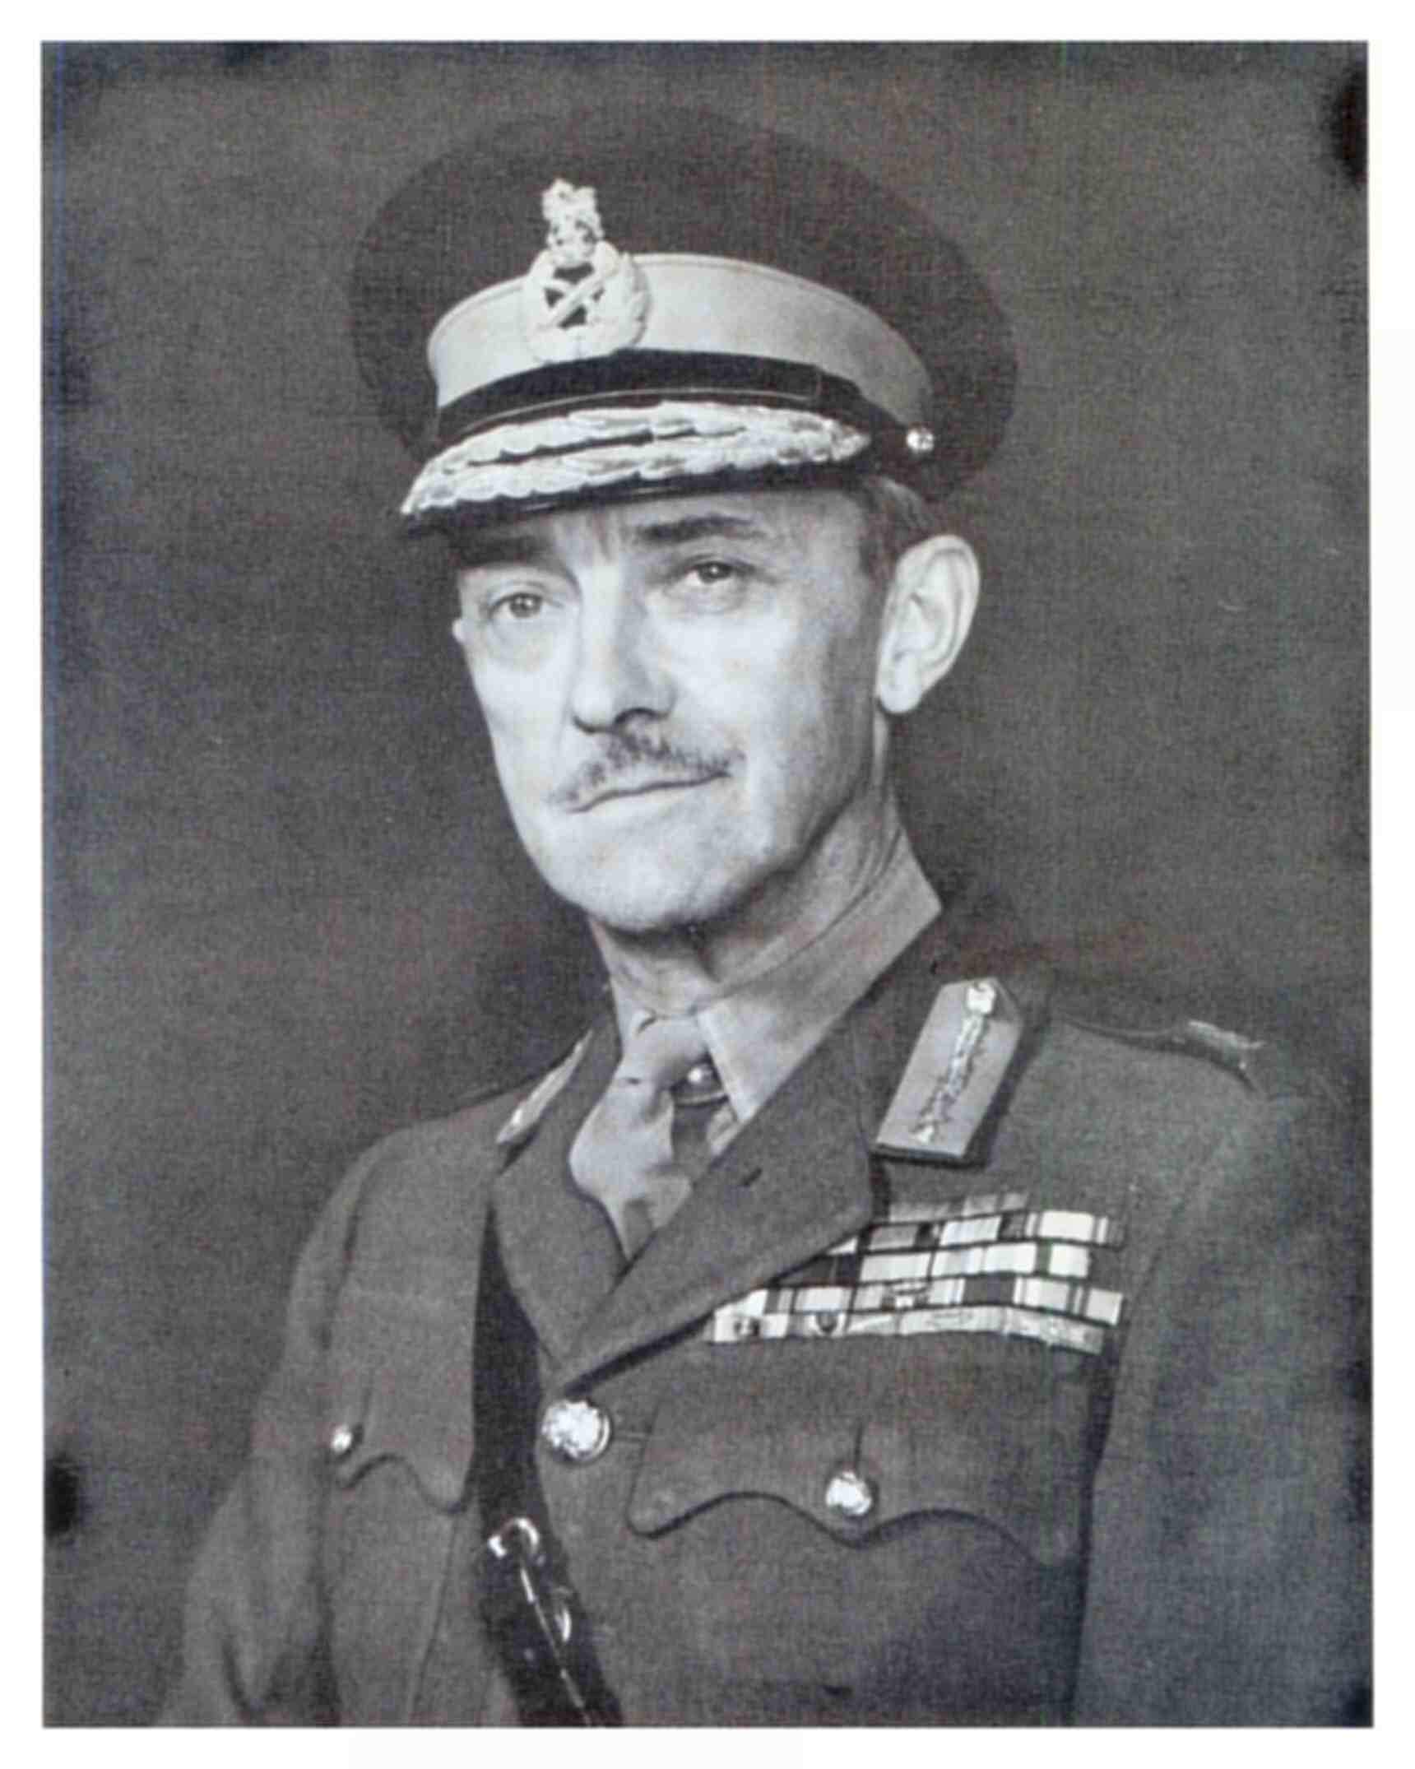

Slide 25
after the war …
under broad emergency powers …
Briggs/Templer nexus introduces slew of efforts to broaden military effort and win over Chinese ‘hearts and minds’:
troops from Fiji, Australia, New Zealand
War Executive Committees at federal, state and district level to coordinate efforts …

Slide 26
after the war …
ruthless military engagement with much collateral damage …
resettled Chinese from margins of jungles into fenced new villages with amenities …
creating zones free of communist influence (White Areas)
measure of success experienced by 1953 …

Slide 27
after the war …
communist insurgency on the peninsula …
taking place against backdrop of intensifying global Cold War …
Soviet-led Commmunist Bloc in Europe and Mao in China …
against American-led coalition of USA, Britain and French …
military conflicts in Vietnam and Korea* …

Slide 28
after the war …
while fundamental liberties were curtailed …
there were other efforts toward democratisation in the form of local and municipal elections on the peninsula and Singapore …

Slide 29
after the war …
agitation for independence among Malays and other communities and also multi-racial ideological coalitions …
between 1948 and the mid 1950s, inter-racial electoral alliances at the local and municipal level had been formed among the three main communities (Malaya and Singapore) …

Slide 30
Question and Response

Slide 31
towards self-governance ...
March 1948 election saw the establishment of Singapore’s inaugural post-war legislative council …
25 seats …6 elected … 19 appointed by British …

Slide 32
towards self-governance ...
6 liars lawyers elected ...
legislative responsibilities largely superseded by declaration of Emergency of June 1948 …

Slide 33
towards self-governance ...
1951, second election …
25 seats …9 elected …16 appointed ….
Britain proposed steps towards self-governance beyond those accorded to legislative councils of 1948 and 1951 …

Slide 34
towards self-governance ...
1955, third election …
for a 32 seat Legislative Assembly (not Council) …
25 elected … 7 appointed …
multiparty contest ...

Slide 35
towards self-governance ...
Labour Front led by David Saul Marshall ...
well-known and successful criminal lawyer ...
won 10 of 17 seats contested ... 10 of 25 elected rep ...
first chief minister ...

Slide 36
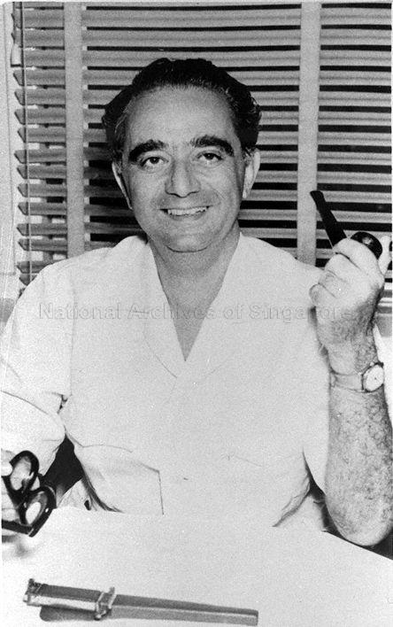
towards self-governance ...

Slide 37
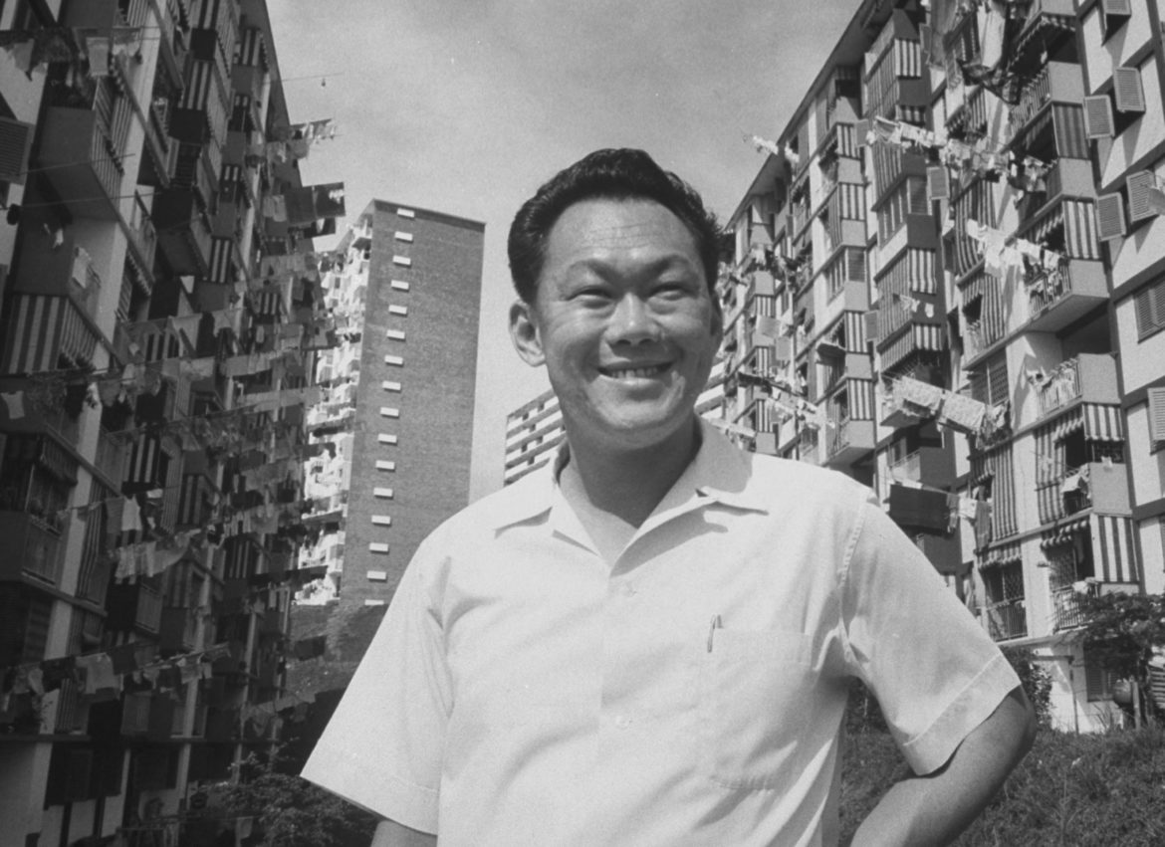
towards self-governance ...

Slide 38
towards self-governance ...

Slide 39
towards self-governance ...
partly to defuse hostile sentiments against colonial rule …
colonial authorities in Singapore had agreed to accept the reformation of the local constitution in 1954, granting Singapore greater internal self-government …
the new administration, led by David Marshall of the Singapore Labour Front, oversaw most domestic matters …
while the British retained control of foreign affairs, internal security, and external defence …

Slide 40
towards self-governance ...
a deal was struck, nevertheless, for both sides to negotiate further for greater internal authority – principally domestic police powers – to be handed over to the local government …
talks were scheduled to be held in London from late April through May 1956 and the Singapore delegation led by Marshall …

Slide 41
towards self-governance ...
the Marshall administration’s ostensible inability to deal decisively with the widespread riots that erupted in 1955 distressed officers such as General Charles Loewen of General Headquarters, Far East Land Forces (GHQFELF) …
what’s the problem ???
Hock Lee Bus riots led to the shut down public services and blocked roads across the island, demonstrated that social disorder in Singapore could isolate the British military installations and cripple British regional military operations ….
any political concessions granted to Marshall must therefore not weaken domestic security in Singapore and undercut Britain’s ability to support the alliance …

Slide 42
towards self-governance ...
Marshall was unaware that London’s position on internal security had stiffened when he declared in the Legislative Assembly in April 1956 …
that he would resign if the Colonial Office refused to surrender domestic police powers to local elected representatives …
with the colonial secretary conceding nothing, the chief minister returned to Singapore from London empty-handed …

Slide 43
towards self-governance ...
outside the assembly, demands were made for more political autonomy …
agitation for political autonomy was becoming increasingly vociferous …
all the above was happening in the midst of a global conflict (Cold War) and domestic emergency …
DON’T FALL OFF YOUR CHAIRS …
Singapore was a politically active society …

Slide 44
Question and Response

Slide 45
1956

Slide 46
1957

Slide 47
towards self-governance ...
there appeared to be a sharp change in British policy between 1956 and 1957 …
while the British were tough on Marshall during the 1956 constitutional talks, they were more conciliatory towards his successor, Lim Yew Hock in the 1957 negotiations ...

Slide 48
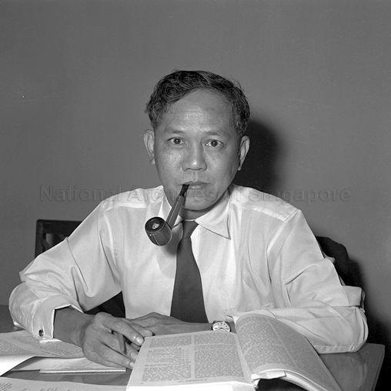
towards self-governance ...

Slide 49
a sharp change ...
a fiasco in Egypt …
in October 1956, the British joined France and Israel in attempting to seize the Suez Canal …
global opinion, however, was against them, forcing them into a humiliating retreat …
and serious damage to an already previously damaged international standing ...
Lim confronted a British government that was keen to restore its moral authority …

Slide 50
towards self-governance ...
in Singapore, local politicians angrily denounced Britain’s imperialist actions …
Lennox-Boyd – mindful of problems with bitterness and violence accompanying devolution of political power…
lamented the fact that the Suez debacle had undercut much of the goodwill that was generated by Britain’s widely-publicised declaration to grant Malaya (and SG) self-government …
the same official who rebuffed Marshall now advised that Lim’s requests should be accommodated at the next constitutional talks ...

Slide 51
towards self-governance ...
Lim resurrected Marshall’s proposal …
the British agreed to Lim’s proposal to form a committee comprising an equal number of British and Singaporean representatives plus one Malayan to manage internal security ...
amendments would be made to the constitution, granting Singapore complete internal autonomy …

Slide 52
Question and Response

Slide 53
Joey …
it analyzes how British strategic considerations …
influenced decolonization … and contributed to the political process in Singapore …
by embarking on such analyses, the traditional themes covered in the history of diplomacy, labour, and politics in Singapore are set in a wider context and hopefully enriched …

Slide 54
Joey …
if historians studying the island’s past adopt an analytical focus that is narrowly national and insular, they will miss much that has had an impact on Singapore …
conversely, to comprehend the multiple dimensions of Singaporean life, it is necessary to enmesh Singaporean history with other histories ..
local history should be investigated in the context and light of other historical events taking place across the globe …

Slide 55
Question and Response

Slide 56
Tutorial 5 …
this Friday and next Monday …
please complete the readings (in order of priority)
Mark R. Frost, “An Unsettled Majority: Immigration and the Racial ‘Balance’ in Multicultural Singapore” in Journal of Ethnic and Migration Studies, 47, 16 (2020), pp. 3729-3751. (Workbin)
Selections from Alfian Saat, One Fierce Hour (Singapore: Landmark, 1998) (Workbin)
Brenda S. A. Yeoh, “Cosmopolitanism and its Exclusions in Singapore” Urban Studies, Vol. 41, No. 12, 2431–2445 (2004) (Workbin)

Slide 57
Question and Response

